Slide 1
How do Financial Regulatory Frameworks Affect Bank Lending
A research empirical project by William Driscoll
ECON 4709/5709

Slide 2
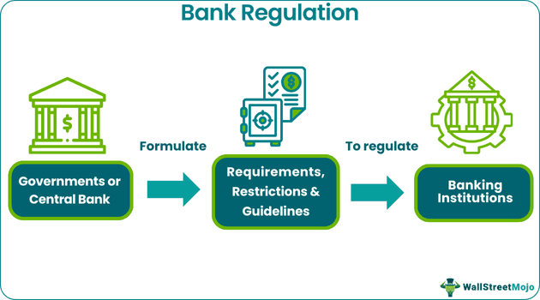
Why Regulate Banks?
Banks are highly leveraged:
Vulnerable to runs and systemic crises
Financial crises lead to large economic costs
Regulation aims to:
Ensure stability
Limit risk-taking
Protect depositors
Banks are central to the economy but inherently fragile due to high leverage and maturity transformation.
This makes them prone to systemic crises, which is why regulators impose constraints on their behaviour.

Slide 3
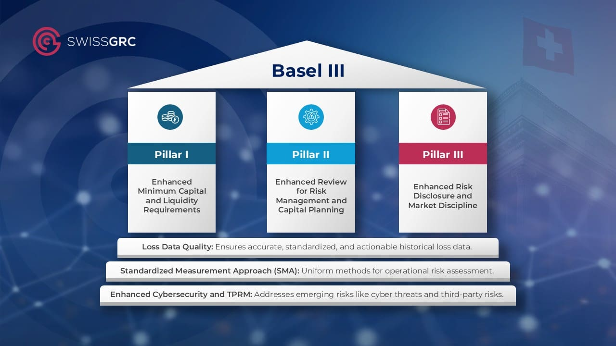
What is Basel III?
Introduced after the 2008 Financial Crisis
Key components:
Higher capital requirements
New liquidity requirements
Leverage ratio constraint
Goal: Increase resilience of banks

Slide 4
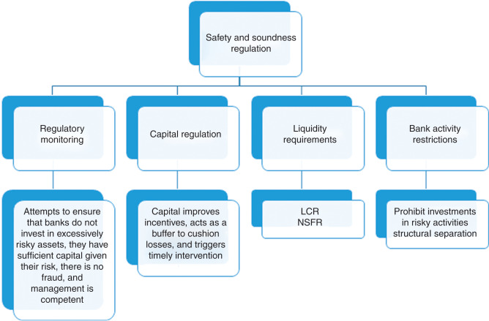
How Does Basel III Affect Bank Lending?
Higher capital requirements =>
Banks must hold more equity
Equity is costly
Forces adjustments
Raise capital
Reduce assets => Reduce Lending

Slide 5
Motivation
Why it matters:
Post-financial crisis regulations (Basel III) introduce capital requirements, stress tests, liquidity regulations, and leverage, with the goal of mitigating the risk of bank runs and bank failures
Understanding how regulation affects lending informs both policy and banking practice impacts financial stability and lending capacity.
Motivation:
Prior studies show regulatory capital affects lending, but there are limited studies using high dimensional datasets, debiased ML, and DiD techniques.
Correia et al. (Forthcoming) “Failing Banks” dataset provides 2.5M quarterly bank reports (1959-2024).

Slide 6
Research Question
Primary Question:
How do regulatory changes, such as the introduction of Basel III, affect bank lending behaviour in the United States?
The introduction of the policy acts as the treatment variable. The changes introduced may mediate the effect of regulation on lending?
Sub-questions:
Does the policy’s impact vary by bank size, risk profile, or historical stress periods? How does the effect change across types of lending? Can Debiased Machine Learning and Difference-in-Differences approaches identify causal effects more certainly that prior methods?
Objective:
Extend prior work (Basel III and Bank-Lending: Evidence from the US and Europe) by using detailed US bank-level data (Correia et al., 1959-2024) to analyze long-term regulatory effects.

Slide 7
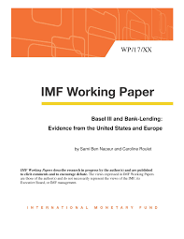
Literature Review (Main Paper)
Key Literature:
“Basel III and Bank-Lending: Evidence from the US and Europe”:
Finds higher capital requirements reduces lending post-regulation.
Uses aggregate and limited cross-sectional data.
Research Gaps:
Limited longitudinal analysis at the bank level in the US.
Interaction of policy with lending responses over time not fully explored.
Need for causal identification using modern techniques.
Opportunity:
Use dataset + Debiased ML + Difference-in-Differences to uncover robust, causal insights.

Slide 8
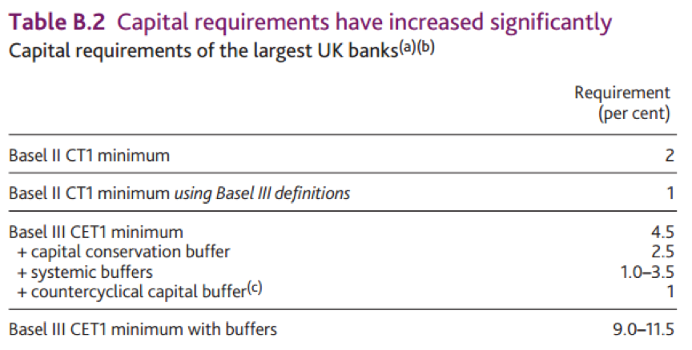
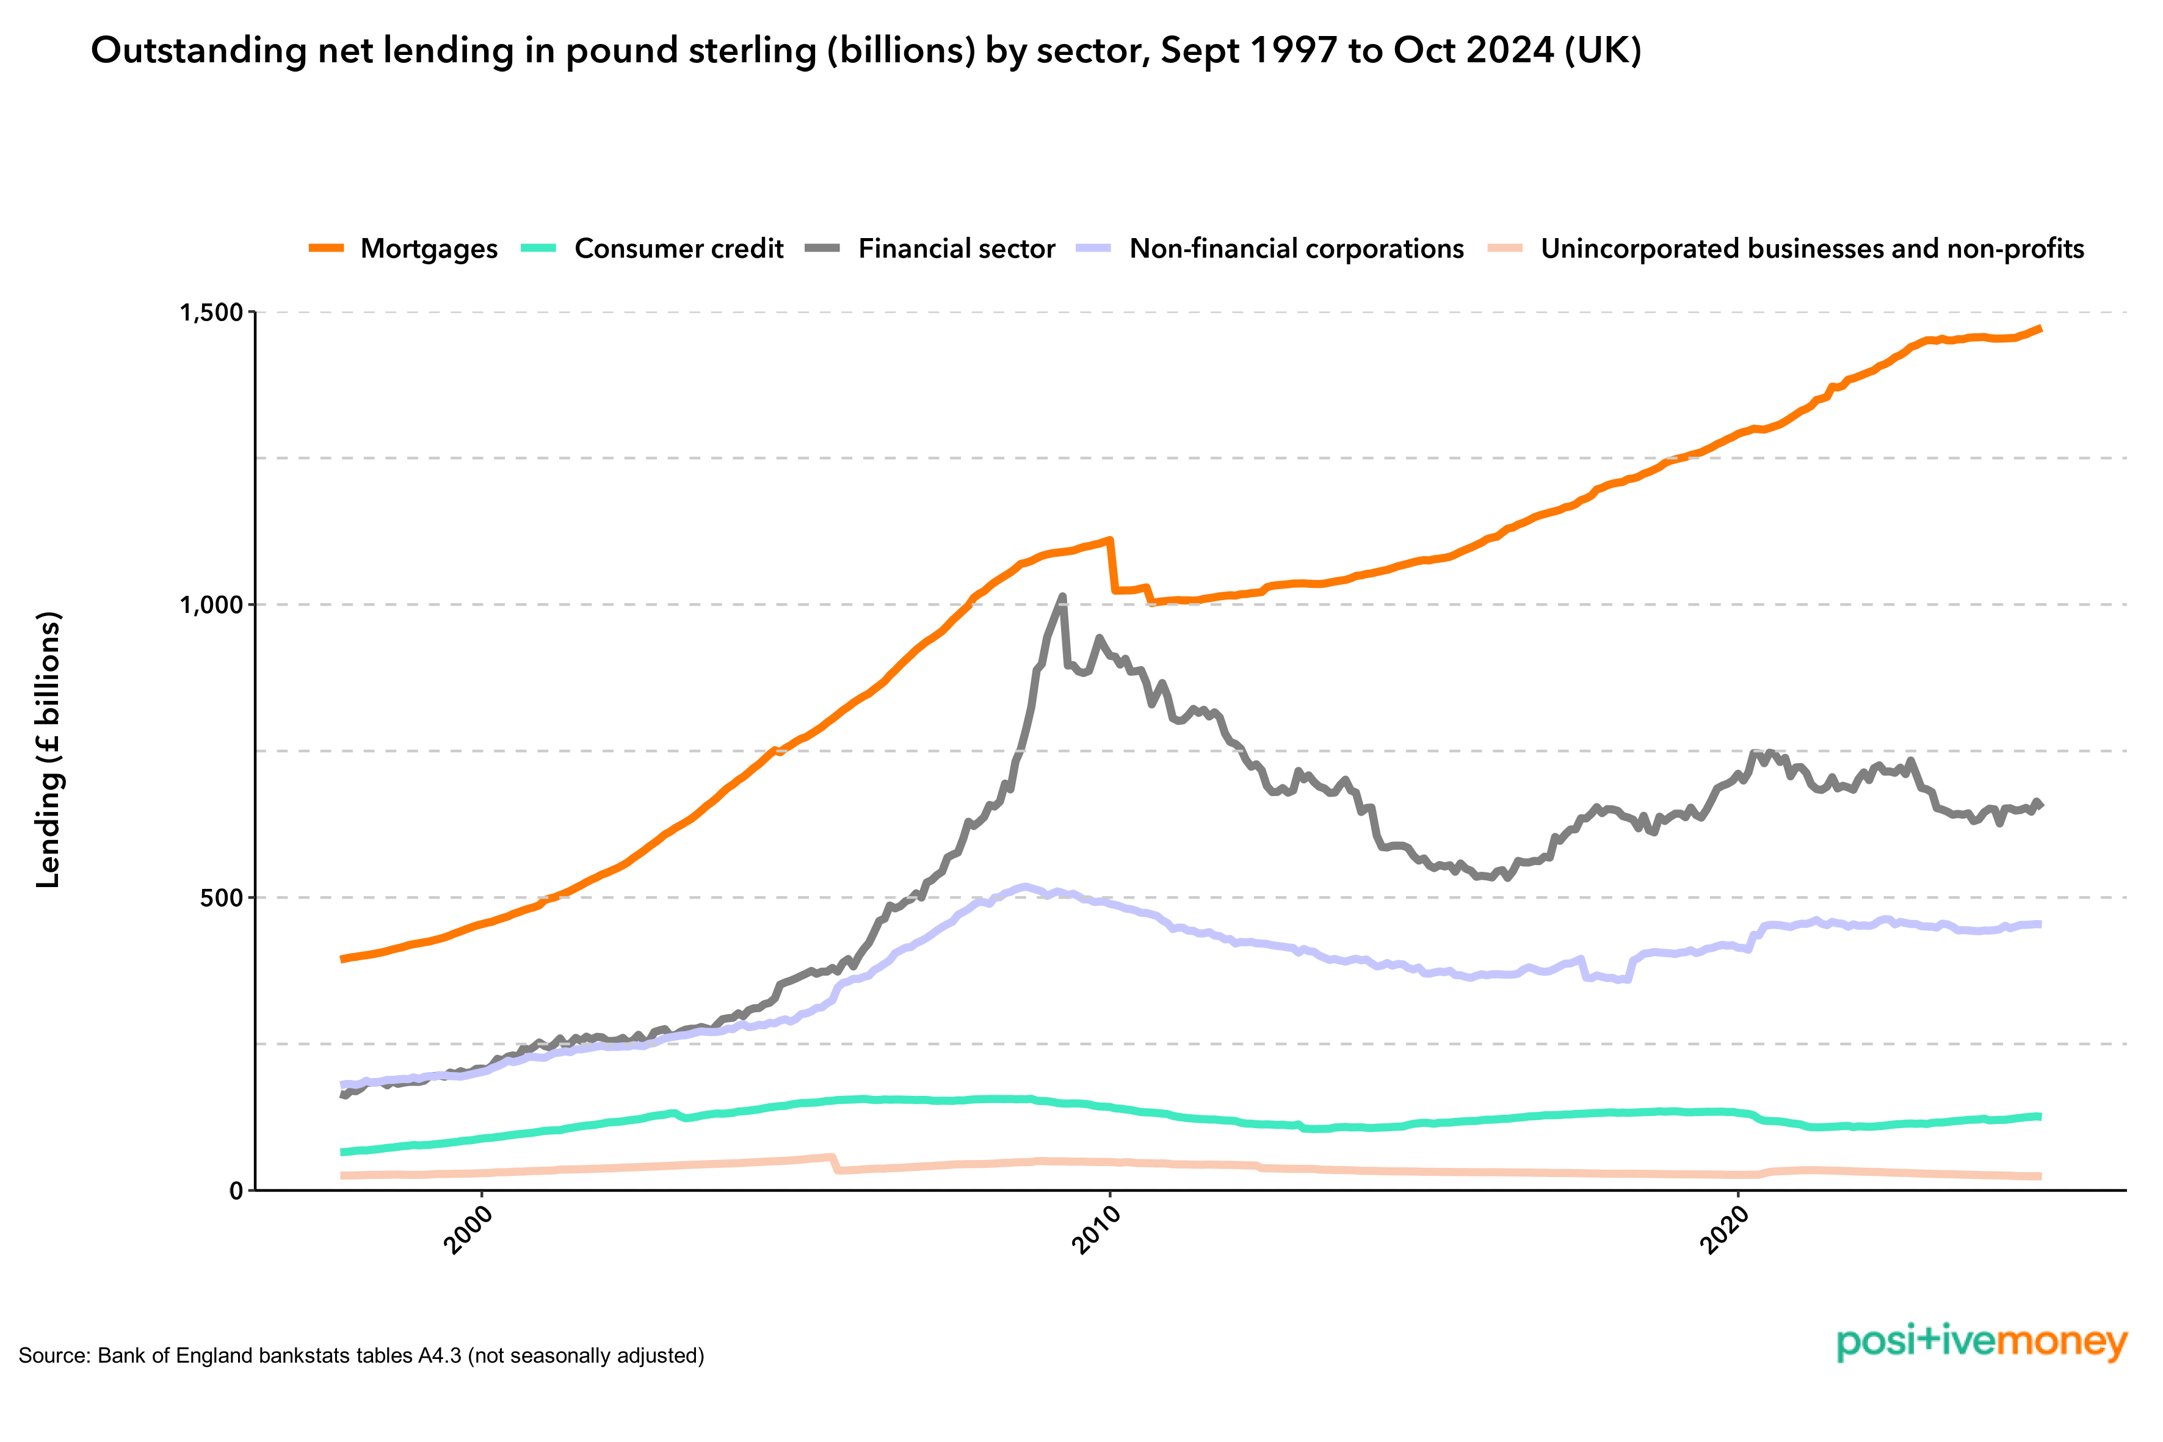
Literature Review
Bridges et al. (2014)
Method: Bank-level panel, capital requirement shocks
Finding: Higher capital requirements reduce lending
Relevance: Same exposure-based identification as my paper
Aiyar, Calomiris & Wieladek (2014)
Method: UK banks + foreign bank comparison
Finding: Constrained banks reduce lending, others substitute
Relevance: Highlights general equilibrium effects
Jiménez et al. (2017)
Method: Loan-level data, firm fixed effects
Finding: Weak banks cut credit supply
Relevance: Solves demand vs supply problem

Slide 9
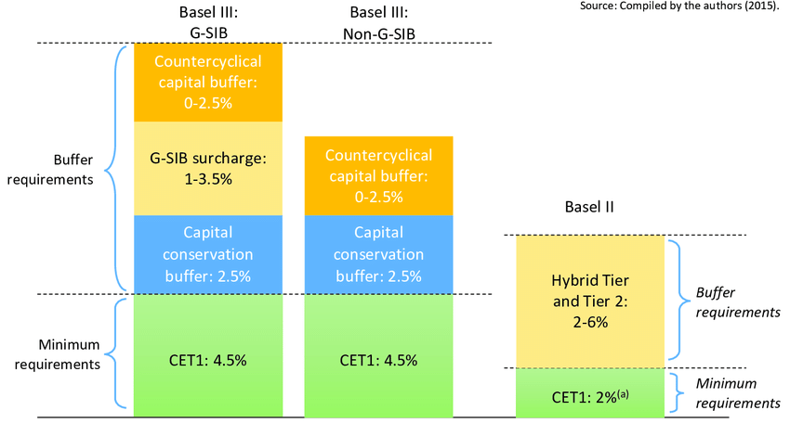
Literature Review
IMF (2017)
Method: Cross-country evidence
Finding: Mixed effects depending on capital constraints
Relevance: Supports heterogeneous treatment effects
OECD (2011)
Method: Macro simulation
Finding: Basel III creates higher spreads, lower short-run lending
Relevance: Macro counterpart to micro evidence
Hazra et al. (2023)
Method: Panel FE regression
Finding: Basel III decrease lending, increase rates
Relevance: Recent confirmation

Slide 10
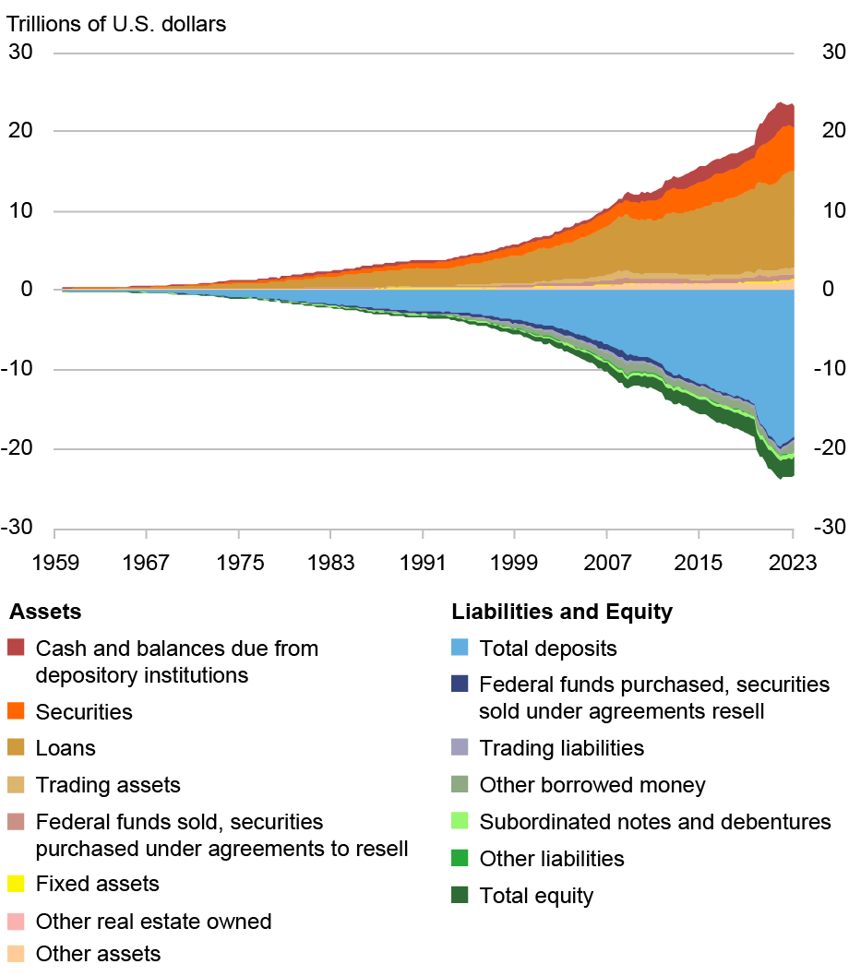
New Dataset Adopted
Dataset: Correia, Sergio A., Stephan Luck, Emil Verner (Forthcoming). “Failing Banks,” Quarterly Journal of Economics.
Features:
A long panel dataset featuring 2.5 million quarterly bank statements (1959Q4 - 2024Q4).
24,710 unique commercial banks.
Variables include Capital Adequacy Ratios (CARs), lending volumes, deposits, total assets, risk metrics, etc.
Data sourced from call reports filed with the Federal Financial Institutions Examination Council (FFIEC).

Slide 11
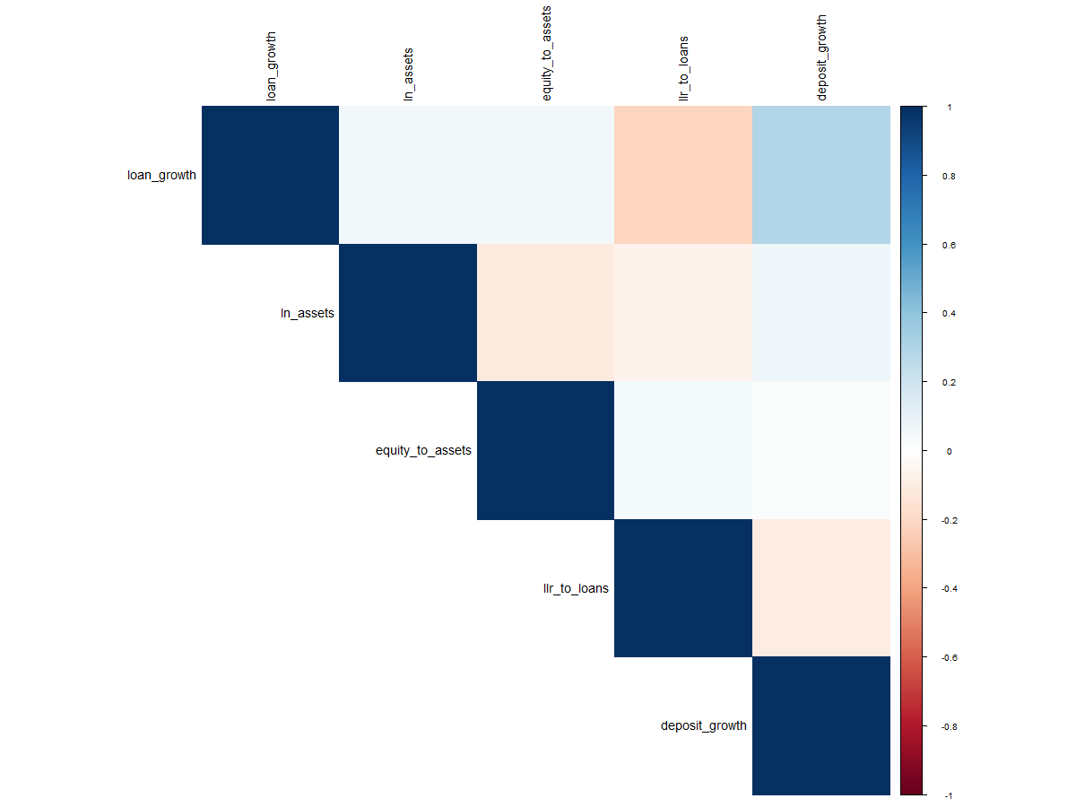
Summary Statistics & Correlations
 | Mean | SD | Min | Max
loan_growth | 1.29 | 5.07 | −12.76 | 22.97
ln_assets | 12.35 | 1.36 | 9.74 | 17.08
equity_to_assets | 0.11 | 0.05 | −2.15 | 1.00
llr_to_loans | 0.02 | 0.01 | 0.00 | 0.05
deposit_growth | 1.48 | 5.35 | −11.78 | 24.22

Slide 12
Dataset Advantages
Comprehensive Coverage - Most US commercial banks from 1863-2024, including both failed and surviving banks.
High Granularity - Detailed balance sheet items: such as loans, deposits, securities, liabilities, and equity
Frequent Timing Information - Quarterly observations allow for dynamic modeling of bank failure and treatment effects.
Data Dictionary Provided - Separate file downloadable displaying labels and meanings of all variables
Flexible Outcome & Treatment Construction - Can derive deposit outflows, lending contraction, capital ratios, and other causal proxies.
Historical & Policy Variation - Covers multiple crises and regulatory regimes, enabling experiments.
Supports Modern Methods - High-dimensional features are ideal for debiased/double ML modeling.

Slide 13
Dataset Disadvantages
Endogeneity Risk - Deposit outflows and lending contraction often respond to bank fundamentals, simultaneity complicates causal inference.
High Collinearity - Many overlapping variables (e.g. Total Loans vs Real Estate Loans) require aggregation or ratio construction.
Limited Behavioral Data - No direct information on depositor or managerial decision-making.
Data Quality Issues - Missing or inconsistent entries, especially in early historical periods.
Rare Event Modeling - Failures are infrequent, may require special statistical methods or oversampling.
Sparse Non-Financial Covariates - Macroeconomic or regional variables must be merged externally.
Time-Varying Accounting Standards - Pre-FDIC/Fed eras introduce potential breaks in reporting

Slide 14
Endogeneity Challenges & Responses
Possible point of endogeneity include:
Non-random policy: Basel III targeted banks differently, pre-existing risk may bias results.
Reverse causality: Bank lending may influence regulatory actions.
Omitted variables: Macroeconomic or bank-specific factors affect both the attributes the policy affects
Heterogeneous effects: Banks are different in in size and risk.
Possible responses include:
Difference-in-Differences (DiD): Controls for time-invariant bank characteristics.
Debiased Machine Learning: Flexibly adjusts for observed confounders, estimates heterogeneous effects.
Robustness checks: alternative situation tests to validate causal estimate claims.

Slide 15
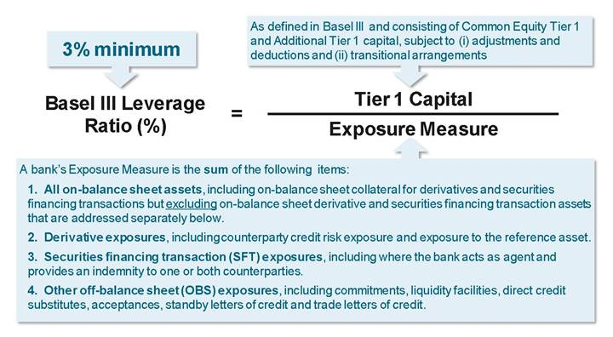
Methodology - Empirical Strategy
Given Basel III implementation rules, effects of regulation on varying sizes of banks is not uniform, and depends on initial capital.
We Utilize:
Cross-sectional variation as exposure
Time variation as implementation
To Compare:
High-exposure vs low-exposure banks
Before vs after Basel III

Slide 16
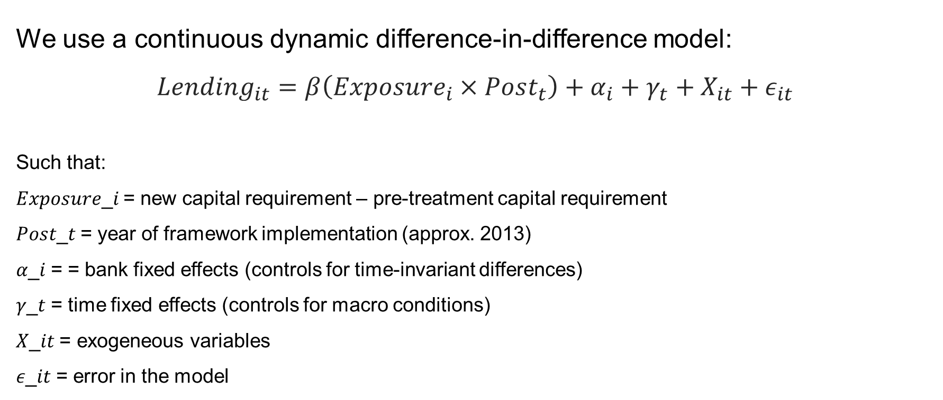
Methodology - Regression Specification
We use a continuous dynamic difference-in-difference model:
$$Lending_{it}=β\left(Exposure_{i}×Post_{t}\right)+α_{i}+γ_{t}+X_{it}+ε_{it}$$
Such that:
𝐸𝑥𝑝𝑜𝑠𝑢𝑟𝑒_𝑖 = new capital requirement – pre-treatment capital requirement
𝑃𝑜𝑠𝑡_𝑡 = year of framework implementation (approx. 2013)
𝛼_𝑖 = = bank fixed effects (controls for time-invariant differences)
𝛾_𝑡 = time fixed effects (controls for macro conditions)
𝑋_𝑖𝑡 = exogeneous variables
𝜖_𝑖𝑡 = error in the model

Slide 17
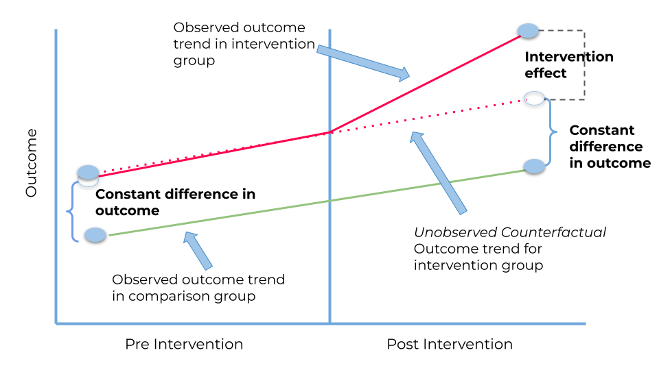
Methodology – Identification Strategy
We compare:
Same bank (i) over time (t) across banks with different exposure
We control for:
Bank characteristics (fixed effects) 𝛼_𝑖
Macro shocks (time fixed effects) 𝛾_𝑡
Key model assumption: Parallel trends hold, where absent Basel III, high and low exposure banks would have followed similar lending trends.

Slide 18
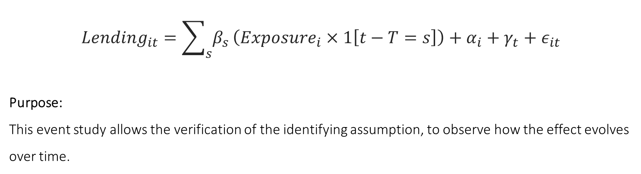
Methodology - Dynamic Effects
$$Lending_{it}=\sum_{s}{β_{s}}\left(Exposure_{i}×1\left[t−T=s\right]\right)+α_{i}+γ_{t}+ε_{it}$$
Purpose:
This event study allows the verification of the identifying assumption, to observe how the effect evolves over time.

Slide 19
Methodology – Key Variables
Treatment Variable: Regulatory change introduction policy shock (Basel III).
Exposure Variables: Pre-2010 capital ratio
Outcome Variable: Bank lending behaviour (deposit and loan growth from the last period).
Identification Strategy:
  Difference-in-Differences (DiD): Compare treated vs. control banks pre- and post-policy.
  Debiased Machine Learning (DML): Control for confounders and improve causal inference.
Controls / Robustness:
Bank size, risk profile, geographic factors, historical stress periods.
Placebo tests and alternative specifications.
Goal: Estimate causal effect of regulation on lending while accounting for heterogeneity.

Slide 20
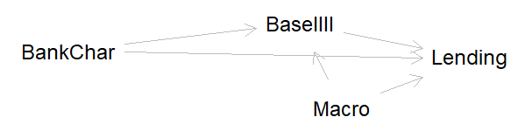
Causal Assumptions (DAG)

Slide 21
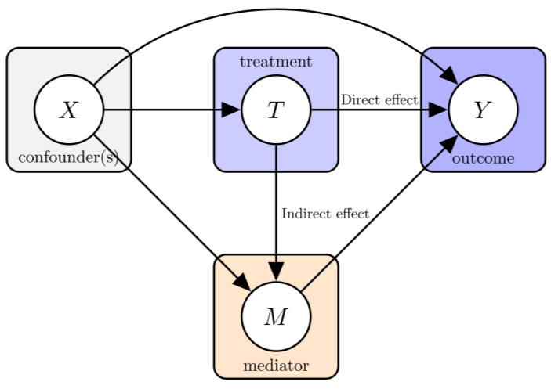
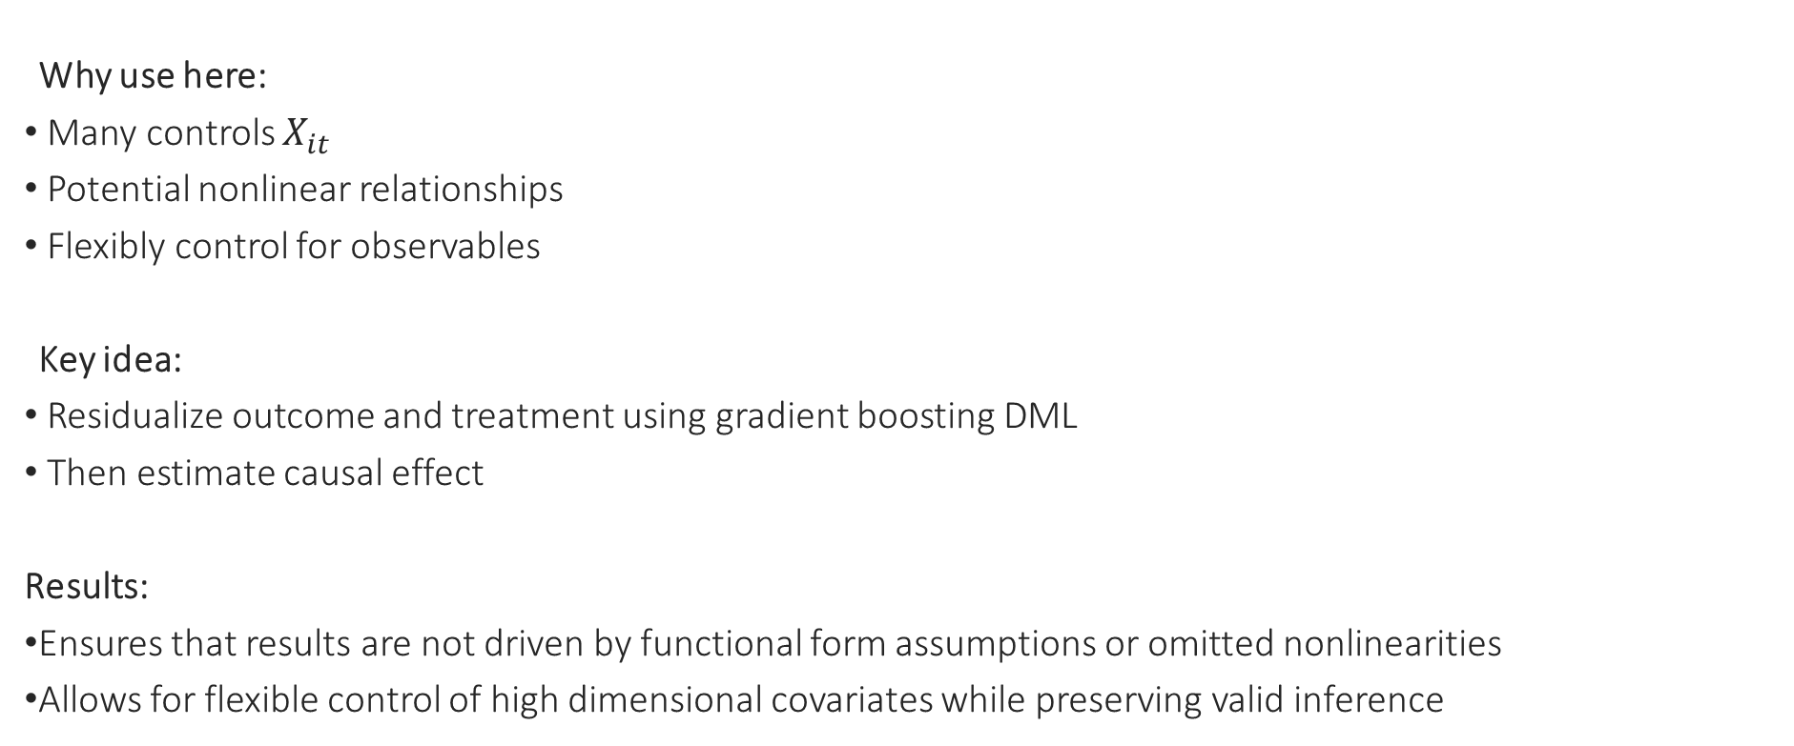
Robustness & Debiased Machine Learning
Why use here:
Many controls $X_{it}$
Potential nonlinear relationships
Flexibly control for observables
Key idea:
Residualize outcome and treatment using gradient boosting DML
Then estimate causal effect
Results:
Ensures that results are not driven by functional form assumptions or omitted nonlinearities
Allows for flexible control of high dimensional covariates while preserving valid inference

Slide 22
Expected Findings
Hypothesis 1: Introduction of Basel III reduces lending for banks with low pre-regulation CAR.
Hypothesis 2: Larger or well-capitalized banks adjust lending less dramatically.
Hypothesis 3: Effect is stronger for riskier loan types and during stress periods.
Hypothesis 4: Debiased ML reveals heterogeneous effects obscured in standard regressions.

Slide 23
Specific Extensions
This research project should extend upon the findings of Jérémy Pépy, and Caroline Roulet by:
Focusing on US bank-level long-run causal effects.
Combining DiD with Debiased ML for robust causal inference.
Quantifies how capital regulation shapes bank lending patterns, informing future regulatory design.
Uses a very large dataset of 2.5 million bank-quarter observations over six decades.

Slide 24
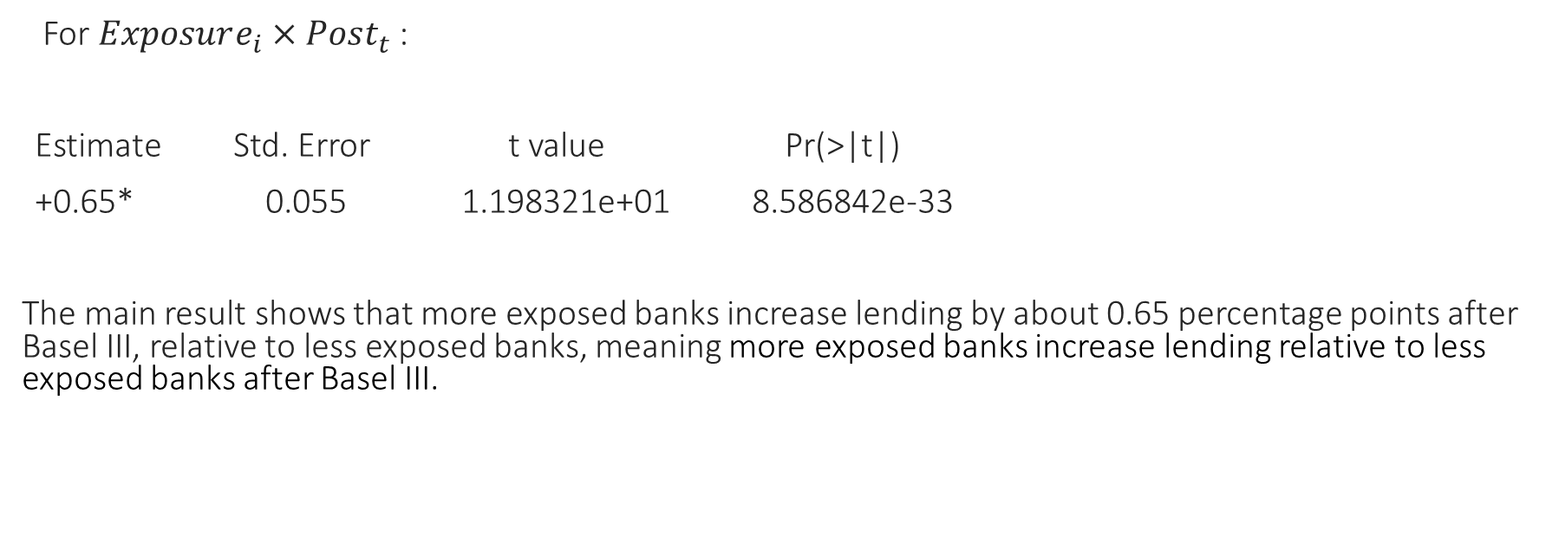
Results – DiD Table
For $Exposure_{i}×Post_{t}$:
Estimate Std. Error t value Pr(>|t|)
+0.65* 0.055 1.198321e+01 8.586842e-33
The main result shows that more exposed banks increase lending by about 0.65 percentage points after Basel III, relative to less exposed banks, meaning more exposed banks increase lending relative to less exposed banks after Basel III.

Slide 25
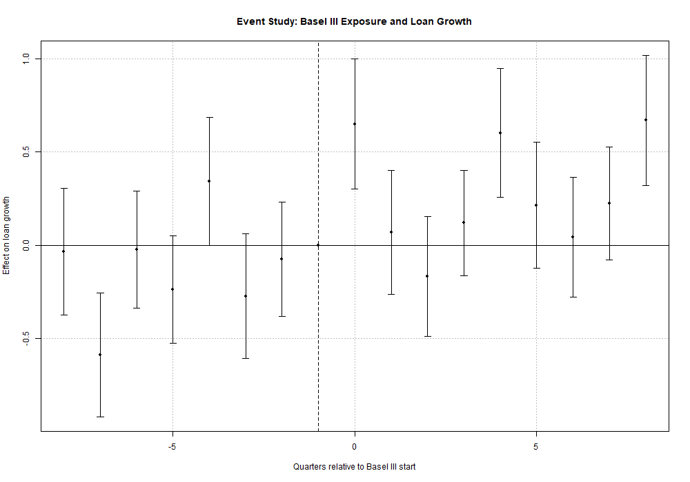
Results - Parallel Trends & Event Study
→ Near no systematic pre-trends across exposure groups
→ Divergence in lending behaviour post policy shock
With bank specific trends, pre-treatment coefficients are centered around zero aproximatly, supporting the parallel trends assumption to a degree. Post-treatment, we observe a gradual increase in lending among more exposed banks.

Slide 26
Results - Interpretation
Evidence of heterogeneous non-uniform responses.
Not all banks reduce lending
Banks adjust several parts of their behaviour at the same time
Consistent with general equilibrium effects. Some banks expand lending while others contract. Regulation affects lending behaviour. These results suggest that regulation does not uniformly reduce lending. Instead, banks adjust along multiple margins, leading to heterogeneous responses.

Slide 27
Paper Links
Basel III and Bank‑Lending: Evidence from the United States and Europe
Authors: Sami Ben Naceur, Jérémy Pépy, and Caroline Roulet
Publication: IMF Working Paper No. 2017/245
Year: 2017
Link (PDF): Download the IMF working paper PDF
Summary: Uses bank‑level panel data on U.S. and European banks to analyze how Basel III‑style capital and liquidity measures affect bank lending growth after the 2008 crisis.

Slide 28
Citations
Literature Review
Jérémy Pépy, and Caroline Roulet. "Basel III and Bank-Lending: Evidence from the United States and Europe", IMF Working Papers 2017, 245 (2017), accessed 3/3/2026, https://doi.org/10.5089/9781484328309.001
Dataset
Correia, Sergio A., Stephan Luck, and Emil Verner. Forthcoming. “Failing Banks,” Quarterly Journal of Economics.

Slide 29
Questions?

